Slide 1
Testing Results
2016-2017

Slide 2
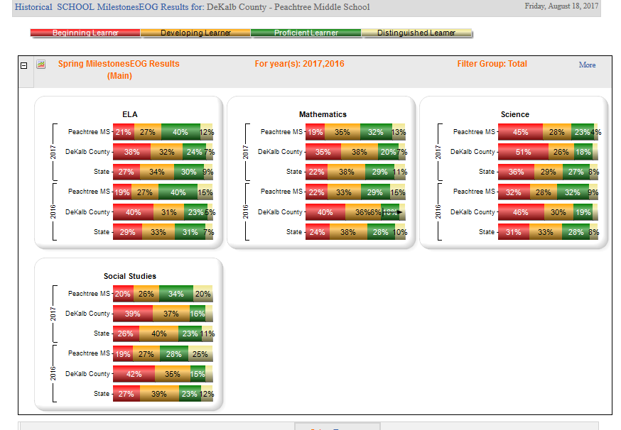
End of Grade-GA Milestones

Slide 3
End of Course test
Physical Science
Coordinate Algebra
1%-Beginning Learner
5%-Developing Learner
45%-Proficient Learner
50%-Distinguished Learner
3% Developing Learner
31% Proficient Learner
66% Distinguished Learner

Slide 4
Fall MAP Assessment
Reading
Math
17% Below 21 percentile
13% 21-40 percentile
18% 41-60 percentile-Average
25% 61-80 percentile
27% greater than 80 percentile
18% Below 21 percentile
16% 21-40 percentile
19% 41-60 percentile-Average
23% 61-80 percentile
24% greater than 80 percentile

Slide 5
DCSD Curriculum
Located in VERGE for all teachers.
Focuses on six units of studies with identified priority standards and supporting standards.
Each unit will have four task which require the student to apply what they have learned (Engaging Scenarios).

Slide 6
Peachtree Charter Middle School’s
World Language Department

Slide 7
The mission of the world languages program is to equip all students with lifelong skills that will allow them to communicate effectively, to collaborate, to think and to interact in a global society, and to appreciate other languages and cultures, as well as their own.

Slide 8
7th and 8th grade classes correspond to one-half of the high school level course of the same title. By the end of the 8th grade, your child will be completing the entire course for Level I of either Spanish or French – for a total of 72 weeks!
(In the high schools the students take the same course in 18 weeks.)

Slide 9
A successful student…. 1) Is a motivated self-starter who wants to study a World Language. 2) Studies 20 min/night & does every homework assignment. 3) Understands that study habits are different from those used for success in other classes, and are implemented consistently & daily.

Slide 10
4) Can learn and put to use techniques that will at once reinforce World Language skills and those taught in the core classes, i.e. lang. arts, math, social studies & science. 5) Knows the importance of neatness and organization. 6) Is ready for a class that is based in analytical thinking skills

Slide 11
And finally… 7) Is prepared to use a high school text, follow high school curriculum, ready to take responsibility for his/her own work.

Slide 12
How does the high school credit work? After your student passes every semester with a grade of 70 or better, the semester grades in 8th Grade only are then placed on his/her permanent High School Transcripts. Each semester grade is a distinct mark on the transcript, but are averaged into the permanent GPA.

Slide 13
English/Language Arts Reading and Writing

Slide 14
Reading: What you can do?
1.Read! Help your child find a book they ENJOY!
2. Take a trip to the library or bookstore. Have fun while choosing books to read.
3. Find an author that your child likes and have them attempt to read all of their books.
3. Read with them. By reading out loud students can become fluent readers.
4. Encourage reading instead of watching television or playing on phones.
5. Find a book that the whole family likes and read together.
6. Focus on vocabulary while reading. Write down new words and master them!

Slide 15
Writing and the Georgia Milestones:
Teachers and students will focus on writing for the Georgia Milestones throughout the year. We are also working towards writing across all content areas so that students are able to carry their writing skills to other subjects.
What types of writing will be on the Milestones?
There will be three constructed-response items. Students will respond to various narratives using textual evidence to back up their responses. One of these constructed-response items will be an extended response and narrative-based. Students will work on constructed-responses routinely throughout the year.
There will also be one extended-response item. Students will respond to a prompt in an informative or argumentative essay. Students will be prepared to answer either essay format.

Slide 16
Writing: What can you do?
Write creatively at home. Give them a fun topic and ask them to respond.
Have them read their writing out loud. Listen and respond effectively.
Focus on the positive more than the negative. Give them examples of what they did right. The teacher will make the appropriate corrections at school.
Be kind when it comes to their writing. Help them without being overly critical.
Encourage them to share their writing from school with you. We want them to show pride in their writing!

Slide 17
MAP Testing: Reading and Language Usage
Students will take two MAP tests throughout the year that deal with ELA: Reading and Language Usage.
Teachers will be working on growth and setting attainable goals with their students.
ELA is going to place an emphasis on Lexile scores this year. We want all students to push past their Lexile levels each year. Lexile scores are available on the MAP reports. Please see your child’s teacher if you would like to know their estimated Lexile score.
Please remind your student to take these tests seriously. We use the results for an array of things throughout their time at PCMS.

Slide 18
The new DCSD ELA Curriculum
Dekalb has adopted a new curriculum for all core content areas.
The foundation of the ELA curriculum hasn’t changed too much, but there are a few additions:
Students will complete four “engaging scenarios,” one for every unit. These will involve students completing tasks to accompany the scenarios. It creates a sense of uniformity among the grade levels.
Students will also take pre and post assessments for each unit. These are a great way for teachers to assess growth at the end of each unit.
Lesson plans are also uniform across the county. They will provide a more detailed outline of the curriculum and units.

Slide 19
Social Studies

Slide 20
Georgia Standards of Excellence
The state curriculum for each subject is designed to explain what needs to be mastered at each grade level.
Additional material is used to support and enrich the standards.
Parents can review the standards at georgiastandards.org.

Slide 21
Grade Levels
Sixth and seventh grades focus on World Studies.
In sixth grade students explore Latin America, Canada, Europe, and Australia.
In seventh grade they learn about Africa and regions of Asia.
At each level they discover more about the physical and human geography of each region in addition to the government, economics and history.
Eighth grade explores geography, history, government and economics, but the focus is on the state of Georgia. The emphasis of the course is Georgia’s role in U.S. history.

Slide 22
Curriculum
The state and county provide teachers with curriculum maps and frameworks to help implement the standards at each grade level.
This year DeKalb teachers have new units created by the county that they must follow.

Slide 23
DBQ
DBQ refers to Document Based Questions. The address standards across all disciplines. Students analyze sources to write evidence based essays. DBQs are used in social studies but are appropriate tools for other subjects. They are also continued as our students move on to high school.

Slide 24
Mathematics

Slide 25
Middle and High School Math Course Options
Grade | Option 1 | Option 2 | Option 3
6 | Grade 6 | Grade 6 | Grade 6-8 Accelerated
7 | Grade 7 | Grade 7
8 | Grade 8 | Grade 8 | Accelerated Coordinate Algebra /Analytic Geometry A
9 | Coordinate Algebra | Accelerated Coordinate Algebra/Analytic Geometry A | Accelerated Analytic Geometry B/Advanced Algebra
10 | Analytic Geometry | Accelerated Analytic Geometry B/Advanced Algebra | Accelerated Pre-Calculus
11 | Advanced Algebra | Accelerated Pre-Calculus | AP Calculus AB or BC; AP Statistics; Joint Enrollment; other Fourth Mathematics Options as may be created
12 | Pre-Calculus; AP Statistics; other Fourth Mathematics Options as may be created | AP Calculus AB or BC; AP Statistics; Joint Enrollment; other Fourth Mathematics Options as may be created | AP Calculus AB or BC; AP Statistics; Joint Enrollment; other Fourth Mathematics Options as may be created

Slide 26
Standards for Mathematical Practice
Make sense of problems and persevere in solving them.
Reason abstractly and quantitatively.
Construct viable arguments and critique the reasoning of others.
Model with mathematics.
Use appropriate tools strategically.
Attend to precision.
Look for and make use of structure.
Look for and express regularity in repeated reasoning.

Slide 27
Understanding Priority Standards
What are Priority Standards?
Priority standards are the most essential standards for students to master the most critical outcomes of their learning experience.
Priority Standards are “key learnings” that will prepare students for the next grade level
How are Priority Standards determined?
The priority standards were derived from state, and national standards by teams of Prek-12 Dekalb County School District teachers, principals, and instructional coaches.

Slide 28
Performance Task
grade-level formative performance assessment tasks with accompanying scoring rubrics and discussion of student work samples. They are aligned to the Georgia Standards of Excellence.
Performance tasks call for the application of knowledge and skills, not just recall or recognition.
Performance tasks are open-ended and typically do not yield a single, correct
Performance tasks provide evidence of understanding via transfer
Performance tasks are multi-faceted.

Slide 29
Additional Resources
http://nlvm.usu.edu/en/nav/vlibrary.html - National Library of Virtual Manipulatives – virtual activities corresponding to topics from all grade levels – no registration required
www.khanacademy.org
www.virtualnerd.com (from Pearson Education), and
www.ck12.org – explanations for most math topics

Slide 30
Science at Peachtree

Slide 31
An Overview
DCSD has released a new curriculum to enhance our teaching and improve student learning.
There are 6 units for each grade level.
The curriculum has pre and post assessments built into it.
There are performance tasks associated with each unit.

Slide 32
The Standards
The new standards support a curriculum that creates a higher-order learning environment.
We have priority and supporting standards.
S6E1. OBTAIN, EVALUATE, and COMMUNICATE information about current scientific views of the universe and how those views evolved.

Slide 33
The Standards Continued
Here are examples of supporting standards:
DEVELOP a model to represent the position of the solar system in the Milky Way galaxy and in the known universe.
c. CONSTRUCT an argument that systems of the body (Cardiovascular, Excretory, Digestive, Respiratory, Muscular, Nervous, and Immune) interact with one another to carry out life processes.

Slide 34
An Example of a Performance Task
Opening Phenomenon: When a “naked” egg, an egg with the shell removed, is placed in sugar water the egg will shrink. However a naked egg placed in water (faucet or bottle) will grow or get larger. What makes the eggs act in this manner? Other materials such as red blood cells, grapes, potatoes, carrots, and lettuce leaves act in the same manner when placed in these different types of liquids as well.

Slide 35
The STEM Academy
Available to any 8th grade student.
Has 5 core classes – math, science, Georgia history, ELA, and engineering.
It is possible for students to exit the academy with 4 high school credits:
Accelerated math (EOC)
Accelerated physical science (EOC)
Engineering
Foreign Language
Teachers have flexibility in control of the schedule.

Slide 36
Targeted Assistance
Title I

Slide 37
How are schools identified as TA Title I
Schools are identified by the Free and Reduced (ED-Economically Disadvantaged) lunch percentage
2017 Peachtree was 36.28%
This number determines funding for the 2018 school year. $169,957.74
ED status does not identify TA Title I students.

Slide 38
How are TA Title I students and Teachers identified
Students are identified by a Selection Composite Measure
Two Measures are used
Retention
Academic progress
Fall MAP assessment <21%
Beginning Learner on 2017 EOG
All 1574 students will be assessed and placed in rank order.
Teachers that work with a TA Title I student will be provided additional support.
TA goals and list of expenditures are in the School Consolidated Improvement Plan.

Slide 39
Goals for 2017-2018 school year
Math
By the end of the 2017-2018 school year, we will improve the student mastery of academically rigorous leaning standards in Math as measured by : Increase of the percentage of students scoring proficient or higher on the Math GA Milestones EOG by 2%, meeting state and subgroups performance targets for Hispanic and economically disadvantaged students, meeting or exceeding mean expected growth projection for Math RIT scores on the MAP assessment, and Increase the percent of English Learners with positive movement from one Performance Band to a higher Performance Band as measured by the ACCESS. 2017-79%
English/Language Arts
By the end of the 2017-2018 school year, we will improve the student mastery of academically rigorous leaning standards in ELA as measured by : Increase of the percentage of students scoring proficient or higher on the ELA GA Milestones EOG by 2%, meeting state and subgroups performance targets for Hispanic and economically disadvantaged students, meeting or exceeding mean expected growth projection for Math RIT scores on the MAP assessment, and Increase the percent of English Learners with positive movement from one Performance Band to a higher Performance Band as measured by the ACCESS. 2017-81%

Slide 40
Use of TA Title I Fund
Teacher training
National Title I conference
National Teachers of Math Conference
National Teachers of English Conference
In-House Professional Learning-ex. pay for substitutes
After school tutorials in ELA and Math (three days per-week) and Saturday school second semester.
Cost of Transportation
Technology
MobyMaX, BuzzMath, possibly Read 180/Math 180
Study Island,

Slide 41
Cont.
Parent Engagement
Quarterly meetings
Parent Academies
Only personnel cost is pay for teachers outside of contract hours.

